Slide 1

More Load, More Differentiation - a Design Principle for Deadline-Aware Congestion Control in Datacenter Networks (INFOCOM 2015+Extension+ATC)
Han Zhang, Xingang Shi, Xia Yin,
Fengyuan Ren, Zhiliang Wang
Notes:
Good morning every one, I am ZhangHan from Tsinghua University, My Research Interests are Transport protocol , Scheduling and Virutual transport.
Today my topic is More Load, More Differentiation-a Design Principle for Deadline-Aware Flow Control in DCNs. In this paper, We proposal a principle of designing the deadline aware congestion control protocol and we design a flow control protocol to solve the problem of congestion in DCNs.

Slide 2
Contents
Background
Motivation
Algorithms
Evaluation
Notes:
I will introduce out work from the following 4 aspects. First let us review the background of our research problem

Slide 3

Background
Large purposely-built DCs
Huge investment: R&D, business
Latency is important
OLDI – Online Data-Intensive applications are popular
TCP and DCTCP do not work well.
D2TCP falls short ,as application flows have different value of latency.
more details of flows Deadline should be taken into consideration.
Flow latency in OLDI applications should be guaranteed
Notes:
As we all know ,Nowadays, more and more services and applications such as web search and social networking are hosted in data centers. Since their performance, especially the network performance such as data transfer latency and throughput, directly affect the service quality experienced by end users, thus the revenue of the enterprise. So reducing latency is very important.
Especlically In today’s data center network a popular application is called OLDI application, you may not be familiar with this, so please let me do a small introduction to the
ODDI application. In today’s datacenter network , different application’s flows have different value of latency.
The trational transport protocol data center tcp fall short when dealing with this situation. D2TCP consider deadline, however, as different application have different value of latency, so D2TCP also falls short. Indeed we should not only consider deadline, but also consider the relationship between deadline.
Our goal is to guarantee the latency of the OLDI applications in data center network.

Slide 4
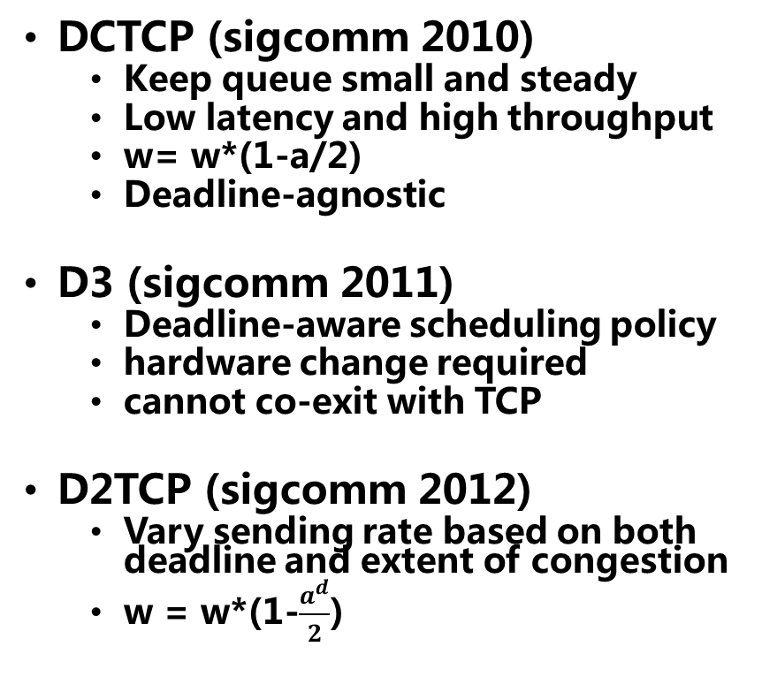
Transport Protocols for Datacenters
DCTCP (sigcomm 2010)
Keep queue small and steady
Low latency and high throughput
w= w*(1-a/2)
Deadline-agnostic
D3 (sigcomm 2011)
Deadline-aware scheduling policy
hardware change required
cannot co-exit with TCP
D2TCP (sigcomm 2012)
Vary sending rate based on both deadline and extent of congestion
w = w*(1-$\frac{a^{d}}{2}$)
PDQ (sigcomm 2012)
Preemptive scheduling at switch
In a distribute fashion
Emulate different policies like EDF, SJF.
L2DCT(Infocom 2013)
Congestion control mechanism
pFabric (sigcomm 2013)
SRPT (Shortest Remaining Processing Time)
Close to optimal
Deadline vs. FCT
We choose deadline as the factor as reducing FCT may not meet the hard deadline of the OLDI APPs
Notes:
Some related work has occuresd to solve this.
DCTCP which is proposaled by Beter than TCP, DCTCP can keep a high link throughput under a small but steady queue length. By reducing the queue length small, it can reduce the queue delay thus reducing the latency. DCTCP adjusts its congestion window by congestion level rather than dropping the congestion window by half when congestion occurs.
DCTCP is good, however, in data center network, different flows may need different value of latency. So deadline is proposaled to present the value of latency.
D3 is a deadline-aware scheduling policy that can schedule flows according to the value of deadline. But D3 need to do some change to the hardware and the flows of D3 can not co-exist with TCP, which restrict the usage of D3.
Inspired by DCTCP, D2TCP is a deadline-aware TCP protocol that can adjust flows’s window size according to deadline and the extent of congestion
D3 and D2TCP are the protocol to guarantee the latency of flows according to deadline. As in data center network the emergency flows are always the small ones so another method to guarantee the latency of flows
Is to reduce the flow completion time.
PDQ is one of the . It do a preemptive scheduling at switch, PDQ is in a decentralized fashion and can empulate different policies like EDF etc.
Inspire by DCTCP, L2DCT is a method to reduce the flow completion time by congestion control. Then pFabric is a optimal solution to this.
If we summarize this, we may find that to reduce the latency of transport, we have two way, one is to guarantee flow deadline, another is
To reduce the flow completion time to guarantee the short emergency one.
Between the two ways, we choose to use deadline, as the factor, because reducing FCT may not meet the hard deadline of the OLDI APPs.

Slide 5
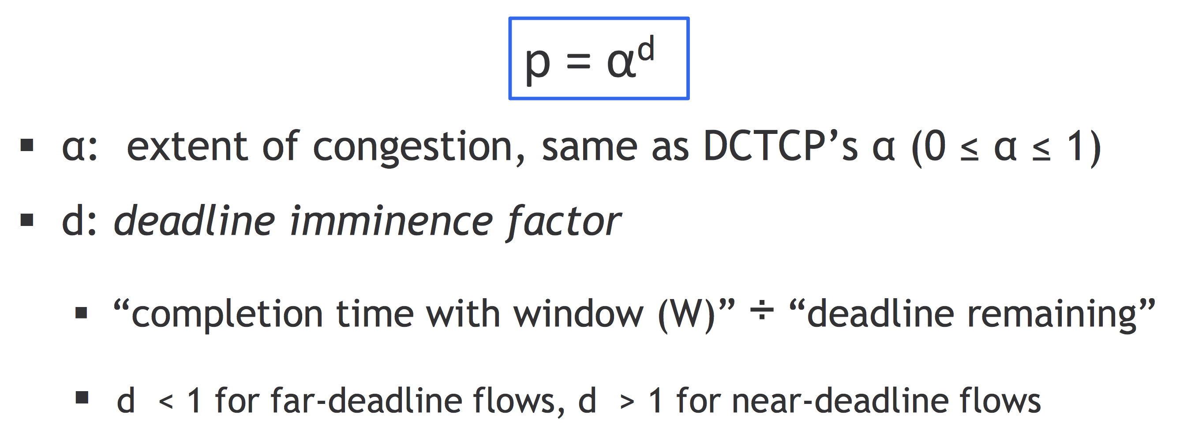
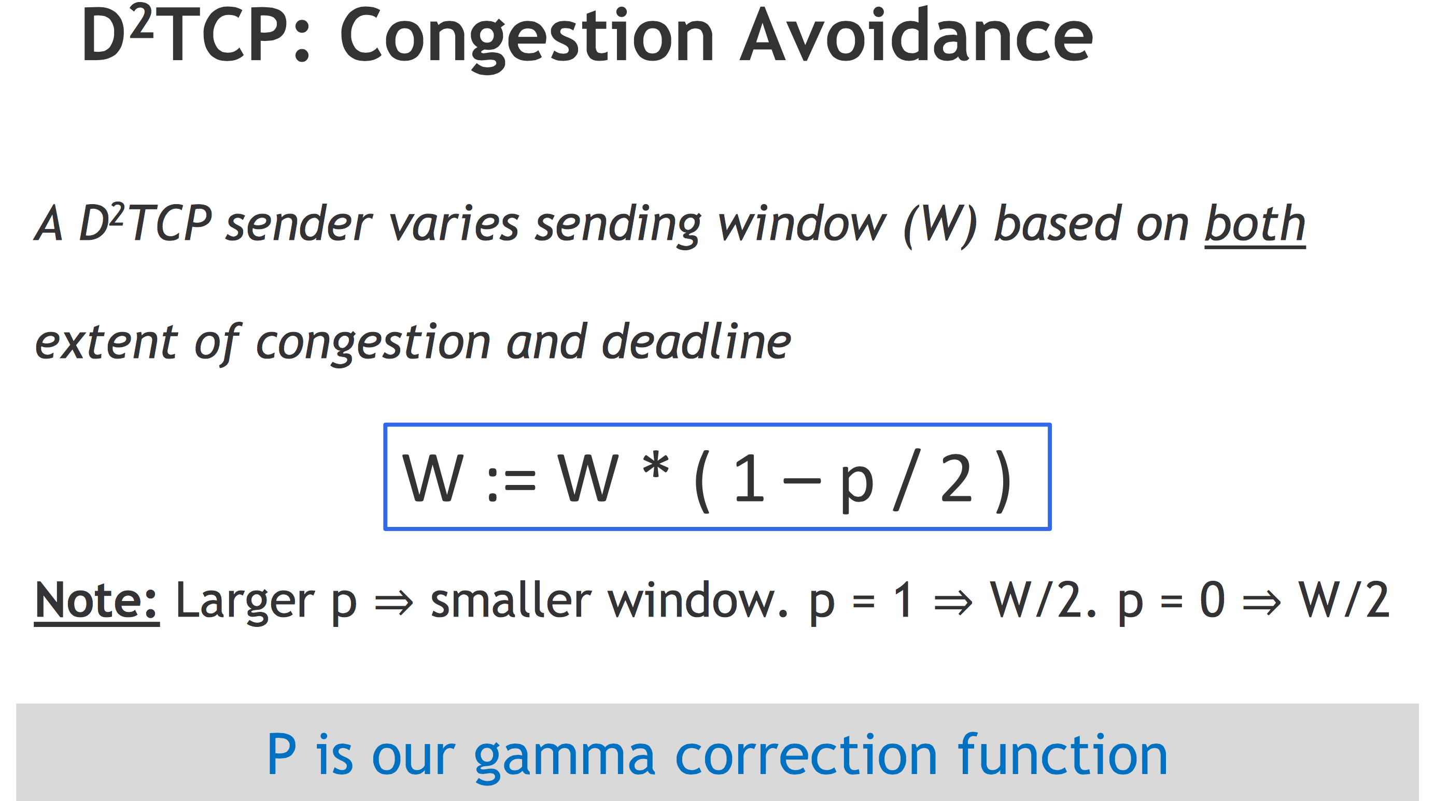
Notes:
As our work is based on D2TCP, so please let me do a simple introduction to D2TCP.
D2TCP works on the congestion avoidance phase.
In D2TCP, the sender send the mount of data according to deadline and the extent of congestion.
When congestion occurs, D2TCP adjust the congestion window according to deadline and the extent of congestion.
When congestion occurs, D2TCP reduce its congestion window according to a penalty function.
The penalty function is gamma function. Lets have a deep look at this.
We can see gamma correction function is indeed a Exponential function. Apha is the extent of congestion just as the same it is in DCTCP.
And d is the deadline imminence factor.
If d is less than 1, the flow is a far-deadline flow, else it is a near deadline flow. And the larger p can lead to a smaller congestion window,

Slide 6
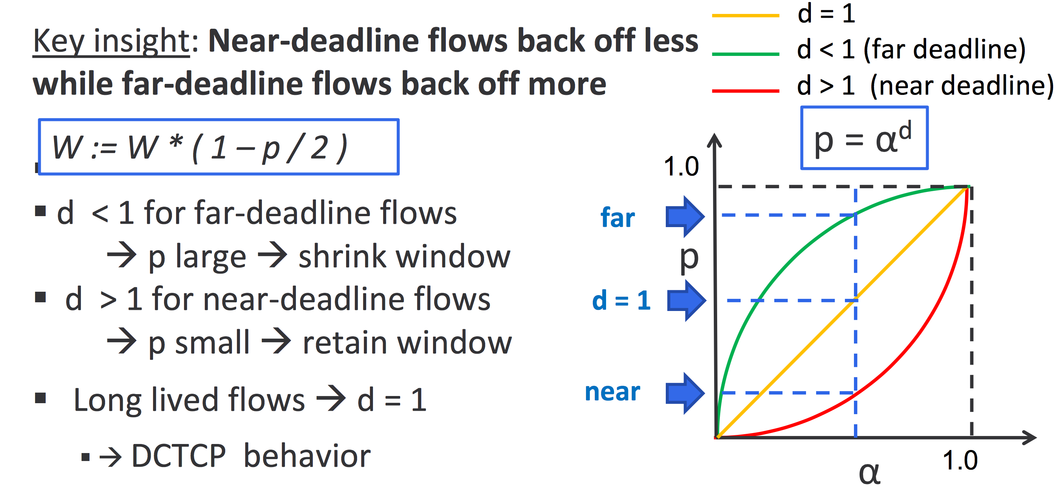
Notes:
In D2TCP the near –deadline flows will back off less while far-deadline flows back off more.
Just look at the picture. If d less than1 for far-deadline flows. P is large and this will shrink the window.
And when d is larger than 1 for near deadline flows, p is small and the sender will retain the congestion window.
For long lived flow d =1 and the d2tcp flows perform like the DCTCP flow.
D2TCP use the congestion control method to solve this and it provides a good solution. However, it also has some flaws.

Slide 7
Contents
Background
Motivation
Algorithms
Evaluation
Notes:
In this part we will introduce our motivation to this problem

Slide 8
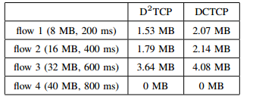
Motivation
NS simulation
1Gbps, RTT=100us
DCTCP VS D2TCP
D2TCP transmits more data than DCTCP
It does not reduce the number of flows that miss deadline.
In both cases, only flow 4 finishes before its deadline
Notes:
We use an experiment to illustrate the problem. In ns-2 simulator, we create a topology that 4 sender send data to a receiver via a switch node.
The rtt of the process is 100 Microsecond. The four flows information is just as the table column 1 show. Then we compare the result of DCTCP and D2TCP.
Column 2 is the result of DCTCP and 3 is the result of D2TCP. The simulation results show that D2TCP can send more data than DCTCP before the flows deadline. But it can not reduce the number of flows that miss deadline, In both cases, only flow 4 finishes before deadline.
This is an interesting result, as D2TCP claims it is a deadline-aware congestion control protocol, but the result shows it perform like DCTCP which is not deadline. To get the reason for this, we get the detail of the flow information.

Slide 9
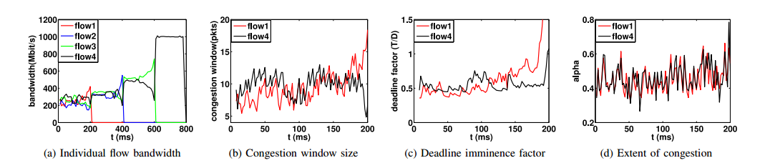
Motivation
After 150ms:
factor(flow1) > factor(flow4)
cwnd(flow1) ≈ cwnd(flow4)
rate(flow1) ≈ rate(flow4)
Why???
Notes:
The 4 picture show some detail information of the process. From the picture we can see that the 4 flows almost have the same value of bandwidth.
Then we print some detail information of flow1 and flow4, from the picture we can see that for flow1 has a larger factor than flow4, and flow1 has almost the same congestion window size as flow4. However, flow1 has almost the same bandwidth as flow4. This leads to the deadline miss. For the reason, we should has a deep insight into the function.
What is your advantage when comparing

Slide 10
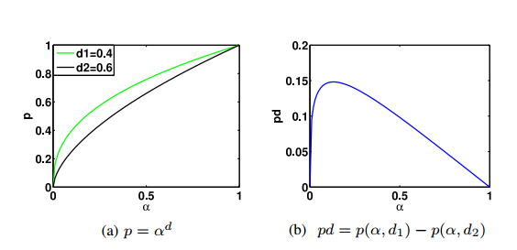
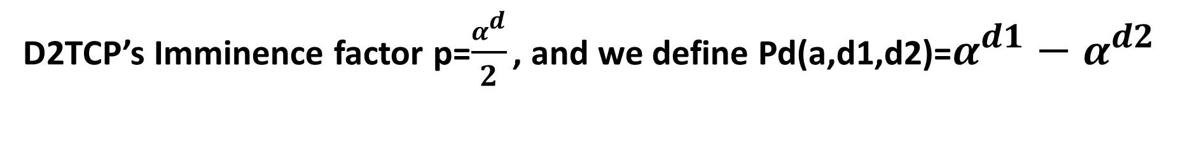
Motivation
D2TCP’s Imminence factor p=$\frac{α^{d}}{2}$ , and we define Pd(a,d1,d2)=$α^{d1}−α^{d2}$
Pd increases at first and then decreases
Pd(0.4,d₄,d₁)=0.116 pd(0.6,d₄,d₁) =0.079 Pd(0.9,d₄,d₁)=0.019
Notes:
Let‘s have a small example of the gamma correction function. The gamma correction function is p = d power of alpha divide by 2.
The we define pd function , it is the difference between d1 power of alpha and d2 power of alpha.
To explain the reason, we just paint two curves that d=0.4 and d=0.6, their value of pd function is as the right figure shows.
From the figure we can see that, when alpha equals to 0.4 , pd is 0.116 and when alpha is 0.6, pd is 0.079
Ad when pd is 0.9 it is 0.019
That is the value of pd increases first and then decreases!

Slide 11
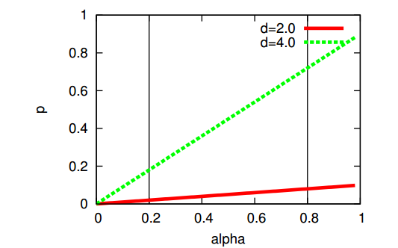
What we need
Principle of Imminence (PI)
The rate of a more imminent flow should be higher than that of a less imminent flow
rate(tight flow) > rate(lax flow)
Implemented in D3 and D2TCP
Principle of Differentiation (PD)
The more heavier the load is, the greater differentiation between flow rates should be made
heavier loads may be regarded, in a plausible way, as evenly reducing the bandwidth each flow can get
Then to meet the tight deadlines as much as possible, some flows should seize some bandwidth from the other flows
Notes:
Indeed, with the increasing of congestion, the value of the penalty function should increase all the time.
Because of this, we proposal two principle:
Principle of Imminence (PI)
The rate of a more imminent flow should be higher than that of a less imminent flow
This principle is that we should differentiate flow which has different value of penalty function.
This principle has already implemented in D3 and D2TCP.
Then we create the principle of T
he more heavier the load is, the greater differentiation between flow rates should be made
heavier loads may be regarded, in a plausible way, as evenly reducing the bandwidth each flow can get
Then to meet the tight deadlines as much as possible, some flows should seize some bandwidth from the PD
The ideal curve should look like this.

Slide 12
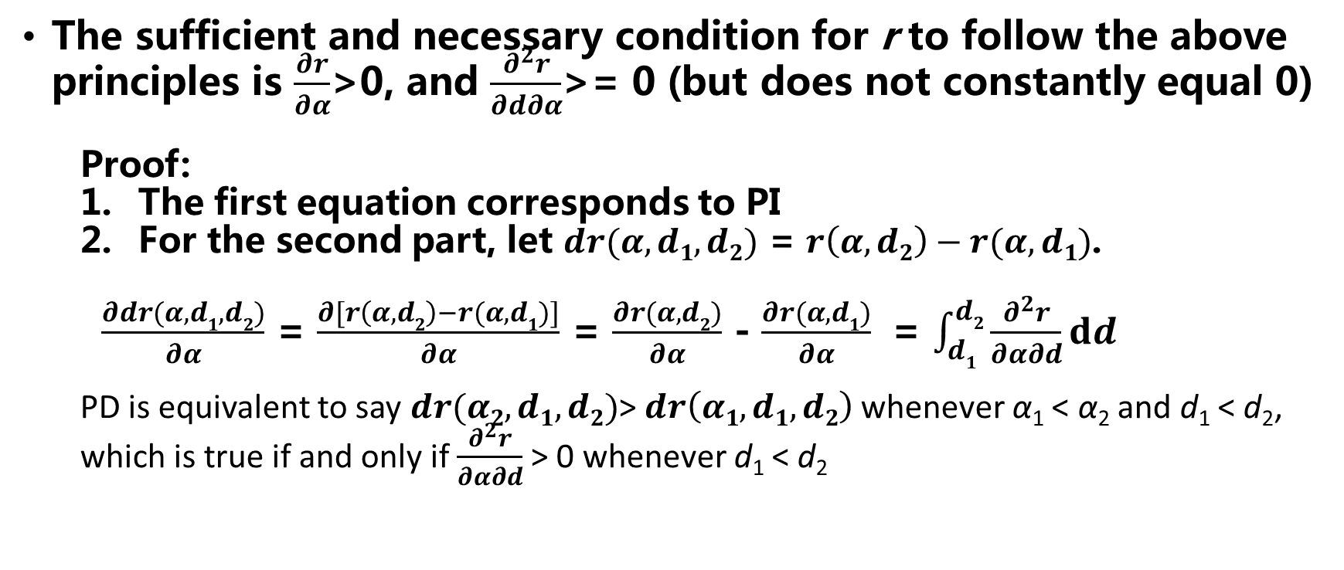
formalization
The sufficient and necessary condition for r to follow the above principles is $\frac{∂r}{∂α}$>0, and $\frac{∂^{2}r}{∂d∂α}$>= 0 (but does not constantly equal 0)
Proof:
The first equation corresponds to PI
For the second part, let $dr(α,d1,d2)$ = $r\left(α,d2\right)−r(α,d1)$.
$\frac{∂dr(α,d1,d2)}{∂α}$ = $\frac{∂[r\left(α,d2\right)−r(α,d1)]}{∂α}$ = $\frac{∂r(α,d2)}{∂α}$ - $\frac{∂r(α,d1)}{∂α}$ = $\int_{d1}^{d2}{\frac{∂^{2}r}{∂α∂d}dd}$
PD is equivalent to say $dr(α2,d1,d2)$> $dr\left(α1,d1,d2\right)$ whenever α₁ < α₂ and d₁ < d₂,
which is true if and only if $\frac{∂^{2}r}{∂α∂d}$> 0 whenever d₁ < d₂
Notes:
To formalize of this, we have The sufficient and necessary condition for r to follow the above principles that is r derivation of alpha larger than 0 and
To Two order partial derivative of d and alpha larger than 0

Slide 13
Contents
Background
Motivation
Algorithms
Evaluation
Notes:
For the third part, we begin our algorithm

Slide 14
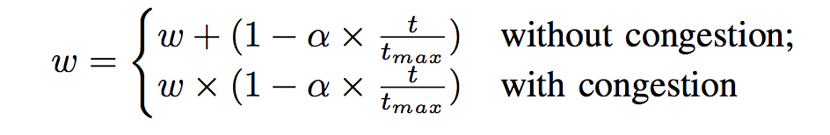
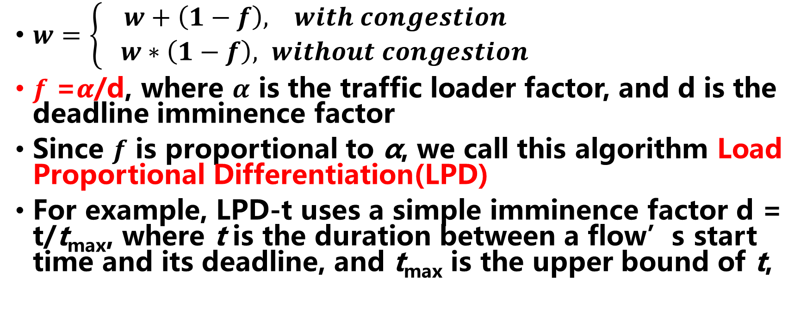
LPD Algorithm
$w=\left\{\begin{aligned}w+\left(1−f\right), with congestion \\ & w∗\left(1−f\right), without congestion\end{aligned}\right.$
$f$ =𝜶/d, where $α$ is the traffic loader factor, and d is the deadline imminence factor
Since $f$ is proportional to α, we call this algorithm Load Proportional Differentiation(LPD)
For example, LPD-t uses a simple imminence factor d = t/t_{max}, where t is the duration between a flow’s start time and its deadline, and t_{max} is the upper bound of t,
Notes:
First we define the LPD algorithm
That is w^
$f$ =𝜶/d, where $α$ is the traffic loader factor, and d is the deadline imminence factor
Since $f$ is proportional to α, we call this algorithm Load Proportional Differentiation(LPD)
For example, LPD-t uses a simple imminence factor d = t_{max}/t, where t is the duration between a flow’s start time and its deadline, and t_{max} is the upper bound of t,

Slide 15
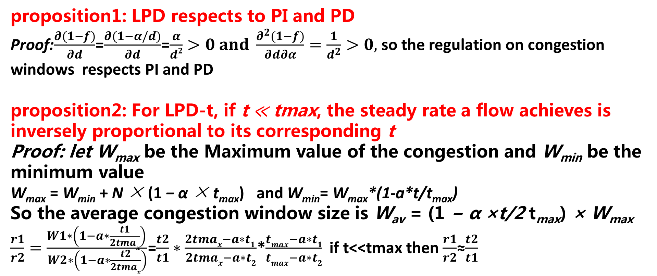
LPD Algorithm
proposition1: LPD respects to PI and PD
Proof:$\frac{∂(1−f)}{∂d}$=$\frac{∂(1−α/d)}{∂d}$=$\frac{α}{d2}>0 and \frac{∂^{2}(1−f)}{∂d∂α}=\frac{1}{d^{2}}>0,$so the regulation on congestion windows respects PI and PD
proposition2: For LPD-t, if t ≪ tmax, the steady rate a flow achieves is inversely proportional to its corresponding t
Proof: let W_{max} be the Maximum value of the congestion and W_{min} be the minimum value
W_{max} = W_{min} + N × (1 − α × t_{max}) and W_{min}= W_{max}*(1-a*t/t_{max})
So the average congestion window size is W_{av} = (1 − α ×t/2 t_{max}) × W_{max} $\frac{r1}{r2}=\frac{W1∗\left(1−a∗\frac{t1}{2tmax}\right) }{W2∗\left(1−a∗\frac{t2}{2tmax}\right)}$=$\frac{t2}{t1}∗\frac{2tmax−a∗t1 }{2tmax−a∗t2}$*$\frac{tmax−a∗t1}{tmax−a∗t2}$ if t<<tmax then $\frac{r1}{r2}$≈$\frac{t2}{t1}$

Slide 16
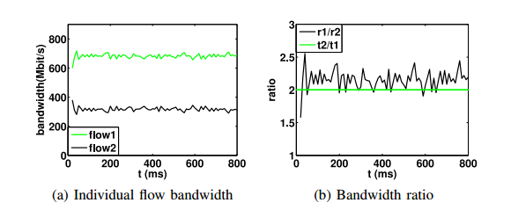
LPD-t Simulation Result
t1=5s,t2=10s,t_{max}=50s

Slide 17
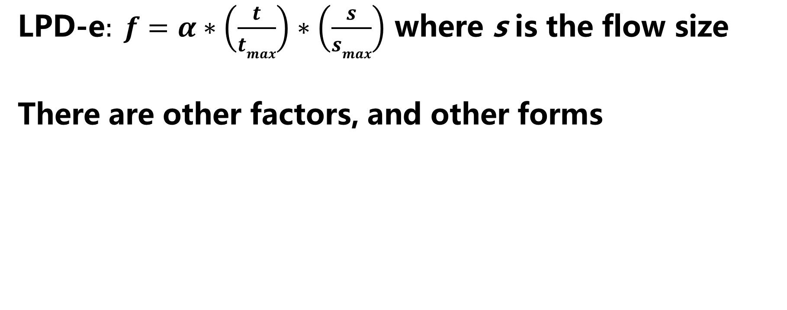
This is a General Principle
$\text{LPD}\text{−}\text{e}: f=α∗\left(\frac{t}{tmax}\right)∗\left(\frac{s}{smax}\right)$ where s is the flow size
There are other factors, and other forms

Slide 18
Contents
Background
Motivation
Algorithms
Evaluation

Slide 19
Evaluation – Revisiting the Motivating Example
D2TCP where d=T/D
cwnd(flow1) ≈ cwnd(flow4)
rate(flow1) ≈ rate(flow4)

Slide 20
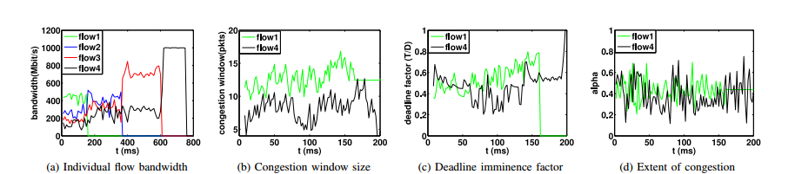
Evaluation – Revisiting the Motivating Example
LPD-d where d=T/D
cwnd(flow1) >cwnd(flow4)
rate(flow1) > rate(flow4)

Slide 21
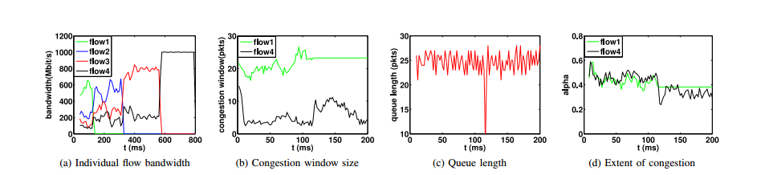
Evaluation – Revisiting the Motivating Example
LPD-t where d = t_{max}/t
cwnd(flow1) >cwnd(flow4)
rate(flow1) > rate(flow4)

Slide 22
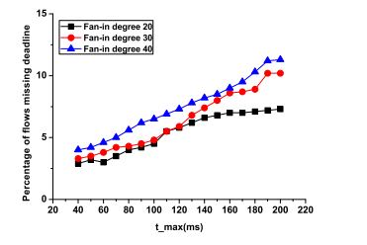
Evaluation - Parameter Selection
Under a tight deadline value t=20ms and random flow size, t_{max} varies from 20ms to 200ms
when t_{max} < 80ms, LPD-t works better than D2TCP
when t_{max} >=140ms, LPD-t’s performance is greatly harmed

Slide 23
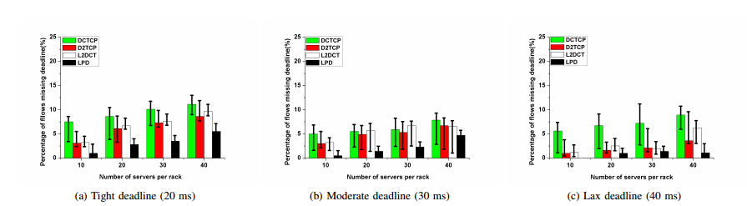
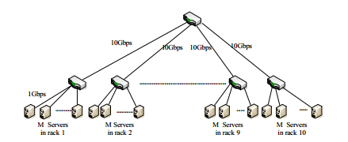
Evaluation – At Scale Simulation In a DC Topology
Deadline missing rate in OLDI applications, under DCTCP, D2TCP, L2DCT and LPD-e
10 racks, each with M=40 servers, in an OLDI application
(flow sizes and fan-in degree matching those used in D2 TCP)

Slide 24
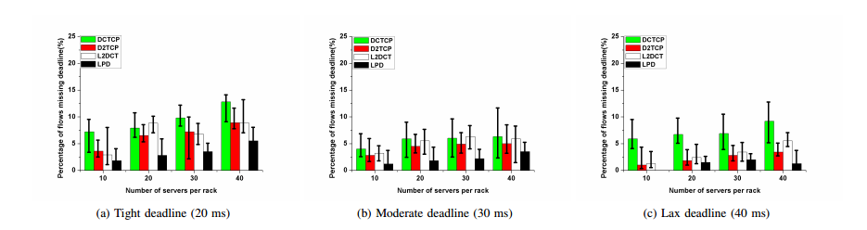
Evaluation – At Scale Simulation With a DC Topology
Deadline missing rate for random flows, in DCTCP, D2TCP, L2DCT and LPD-e
(servers send short Poisson inter-arrival flows randomly to each other)

Slide 25
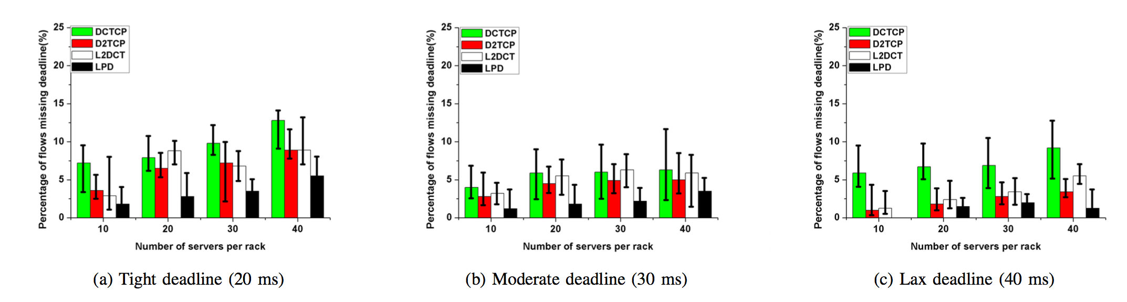
Evaluation – At Scale Simulation With a DC Topology
Deadline missing rate for random deadlines, in DCTCP, D2TCP, L2DCT and LPD-e
(flow size ~ uniform distribution, deadline ~ exponential distribution)

Slide 26
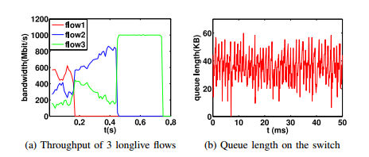
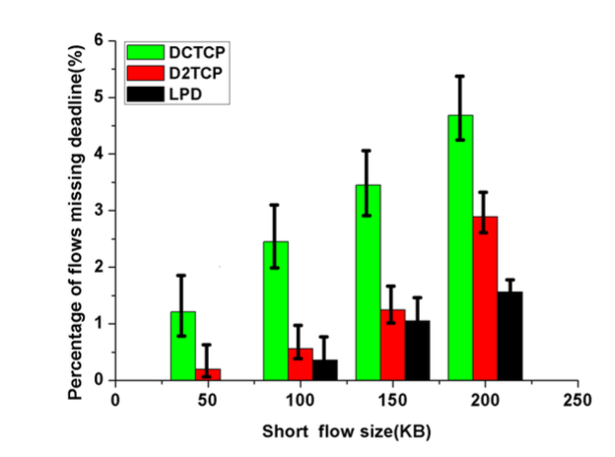
Evaluation – Small Testbed
two switches built with NetFPGA and six servers
Deadline miss rate
in an OLDI application
with increasing flow sizes and fixed deadlines
Flow bandwidth well differentiated
under settings similar to the motivating example

Slide 27
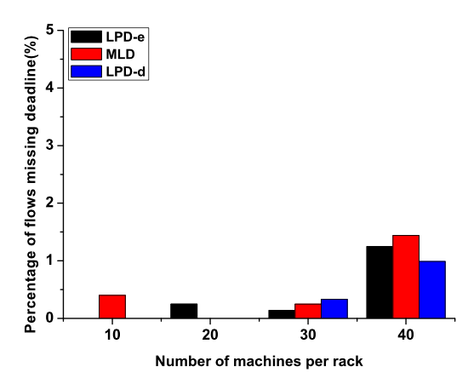
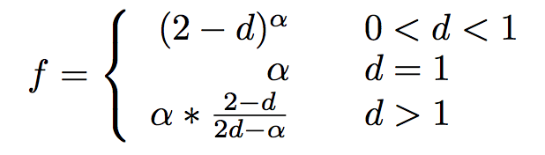
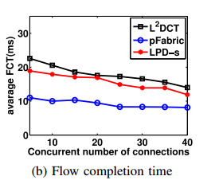
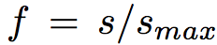
Discussion
Other forms of LPD, e.g., LPD-d and
MLD, have comparable performance
The principle can also be used to
reduce FCT, e.g., LPD-s with

Slide 28
Extension

Slide 29
Web search load

Slide 30
Data Mining load

Slide 31
Web search load

Slide 32
Data Mining load

Slide 33
Web search load

Slide 34
LPD model
fixed point

Slide 35
变换DMAX影响

Slide 36
ATC-Accumulate time congestion control
假设：
应用需要人为设置期限
在数据中心中应用期限难以得
目标：
不设置deadline ,依然能达到deadline的效果
方法：
flow duration time代替deadline
合理性：
持续时间长的流，没有错失期限，认为长流

Slide 37
算法
拥塞窗口
期限因子计算

Slide 38
建模分析
模型

Slide 39
部分实验

Slide 40
Web search

Slide 41
Data Mining

Slide 42
Thanks
Question?
Code of LPD we will be released!

Slide 43
OLDIs
OLDI = OnLine Data Intensive applications
Deadline bound, handle large data
Partition-aggregate
Tree-like structure
Root node sends query
Leaf nodes respond with data
Deadline budget split among nodes and network
E.g., total = 300 ms, parents-leaf RPC = 50 ms
Missed deadlines → incomplete responses
→ affect user experience & revenue
Notes:
Now Let me do a simple introduction of the OLDI application.
The OLDI is short for Online Data Intensive applications. As you know, when handling large data, deadline bound should be considered. The OLDI application is one of the example.
Just as the picture shows the OLDI application is deployed on the partition-aggregate computation model like Hadoop.
The tree-like structure. The root node sends query to the leaf node.
Then the leaf node will respond with data.
The time of the application includes the nodes computation time and the transport time.
The total time is about 300ms RPC
Is as high as 50ms. That means the leaf node should send the result to the root node within 50ms
When miss deadline, the use will get a incomplete response, so the use will have a bad experience so it will
Have a bad effect on the revenue.

